Slide 1
ChIP-Seq Analysis - A Hands on Introduction
06 Feb, 2020
Jitender Cheema
Computational and System Biology
Room 2.26 Bateson

Slide 2

Course Material
Course handbook
http://docs.scicomp.jic.ac.uk/chipseq-course_book/index.html
http://www.biologie.ens.fr/~mthomas/other/chip-seq-training
Repo:
https://git.nbi.ac.uk/jic-scientific-computing-training/chipseq-course
https://www.ebi.ac.uk/training/online/course/ebi-next-generation-sequencing-practical-course/chip-seq-analysis/chip-seq-practical

Slide 3
Goals
Processing Steps: from raw reads to peaks
Down stream analyses:
- Depends on biological question (see if you can find a pattern in the data)
- Where do TF find : tissue context, wild-mutant differences, time points
- Focus on motif analysis
Discussion
Feedback and questions
Please don’t hesitate to ask questions

Slide 4
Do you want to find(map) the chromosomal location of ?
Transcription factors
Nucleosomes
Histone modification
Chaperones
Polymerases
Protein-DNA interaction in vivo
Key task in Modern Biology

Slide 5
Why we will use Command-line ?
Don’t panic
Why command-line ? some will only run from command-lines
To run a program 1000 times don’t have to click 1000 times
Some programs are not installed on your machine we need to connect to the remote machines
We will use Virtualbox: all raw data and tools are already installed for you ☺

Slide 6
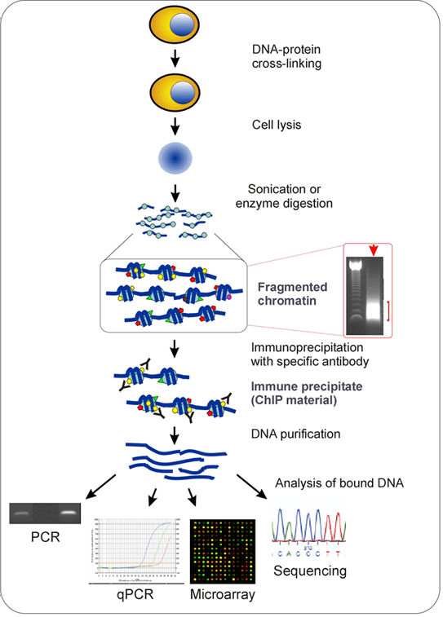
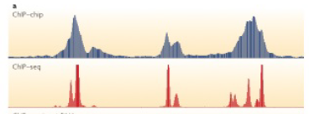
http://www.chip-antibodies.com/
ChIP ( Chromatin Immuno precipitation)
Adapted or used since 2008
Method to detect the bound DNA
Small scale; PCR/qPCR
Large scale: Microarray Chip-on-chip
ChIP seq
Morgan Thomas-Chollier /Park Nature review 2009
Challenge: Quality/Specificity of the antibodies

Slide 7
Do I need a negative control sample?
Without a negative control sample to determine the background noise, the results from the peak finding tools will determine a substantially higher number of false positives. There are a number of negative controls that can be used including:
Nonspecific immunoglobulin G [ IgG]
Input : DNA that went through the process without any specific selection for fragments related to binding of transcription factors
MockIP - usually obtained by performing all the steps in a ChIP protocol with the exception of antibody addition
https://www.nature.com/articles/ni.2117

Slide 8
Input/control/background

Slide 10
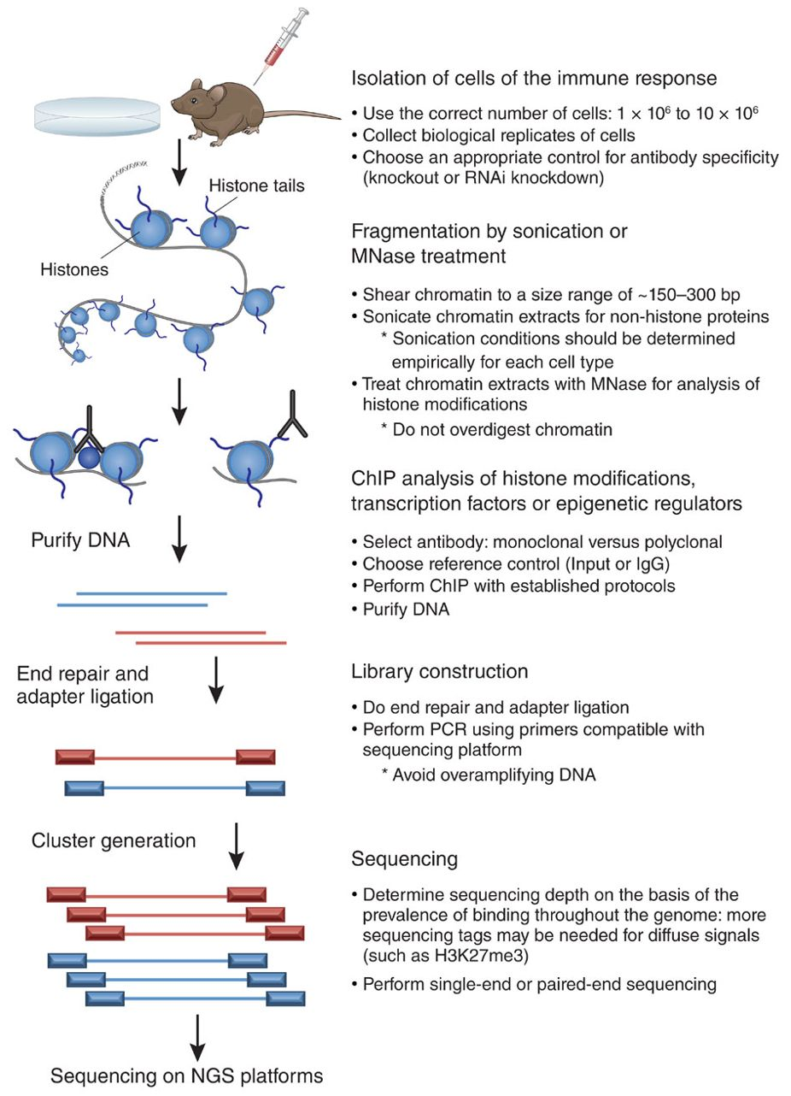
(Kidder et al, 2011) Nature Immunology

Slide 11
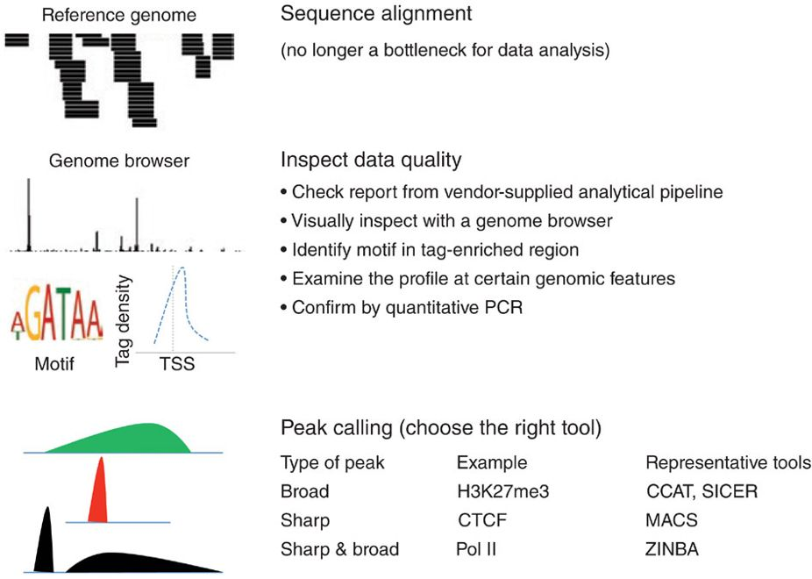

Slide 12
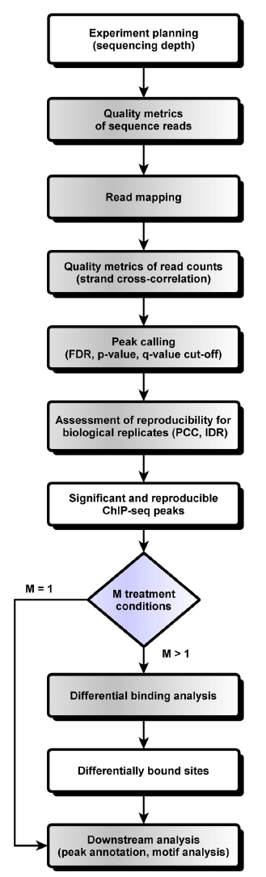
Step by step
“biological question”
Pipeline will vary
Reads to Peak

Slide 13
Raw data … the story begins

Slide 14
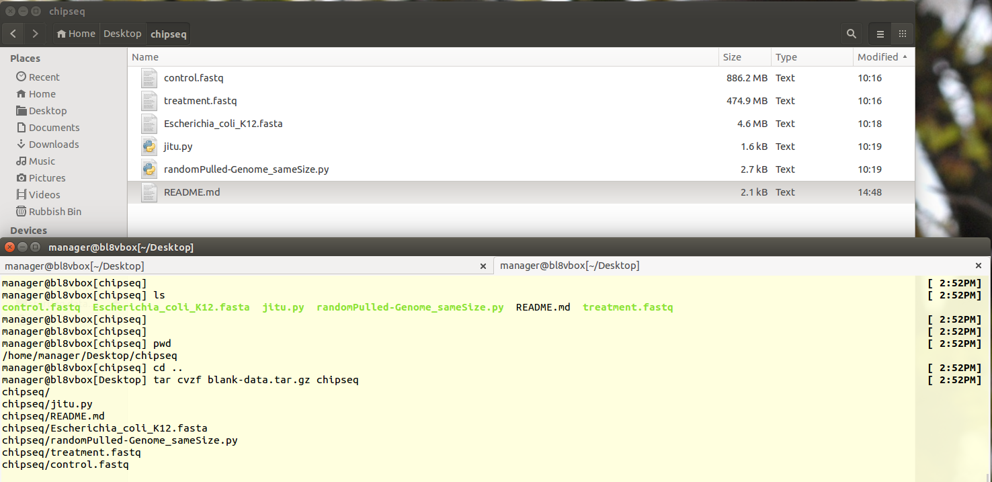
Starting material
Genome wide analysis's FNR and sigma70 in E.coli under aerobic and anaerobic growth
FNR IP ChIP-seq Anaerobic

Slide 15
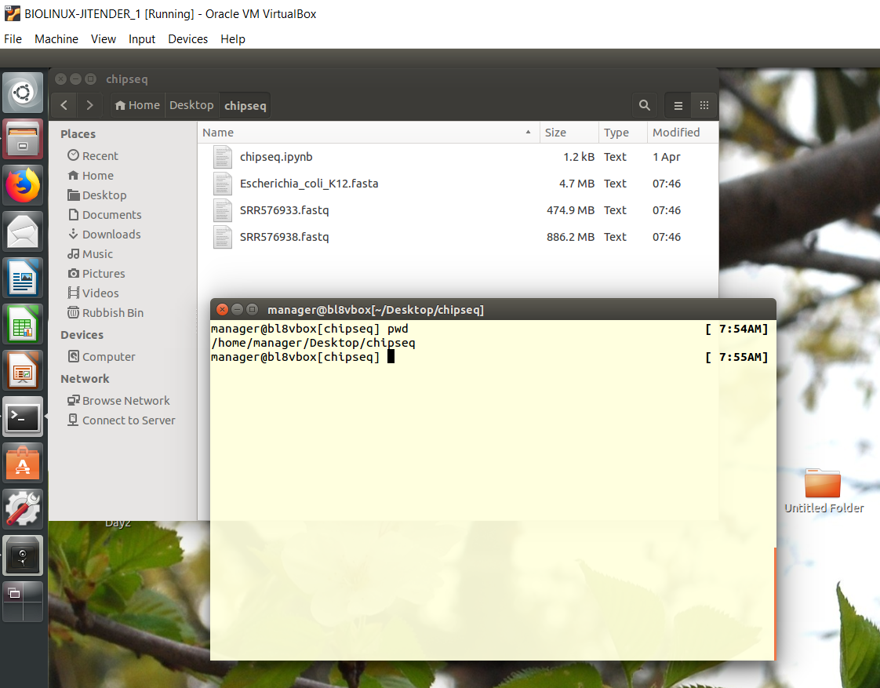
Shall we see Hands on
I have already downloaded for you using the Following
treatment
control

Slide 17
Exercise: Explore Fastq

Slide 18
Quality Control

Slide 19
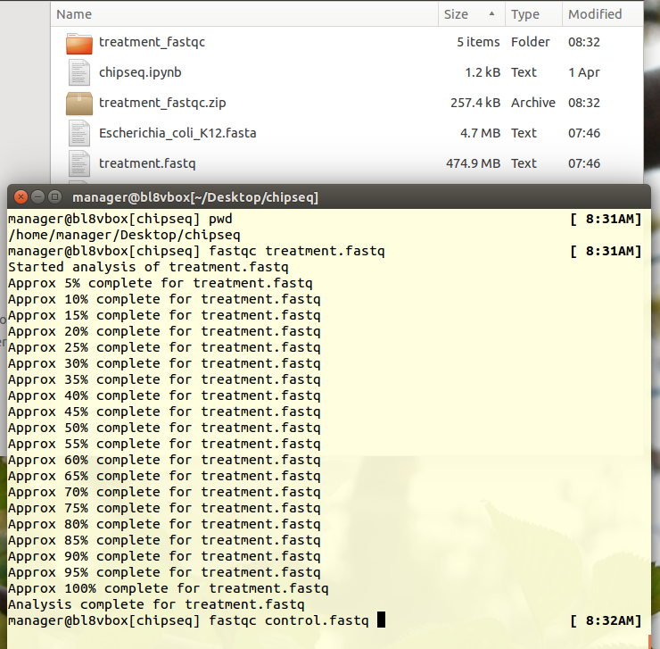

Slide 20
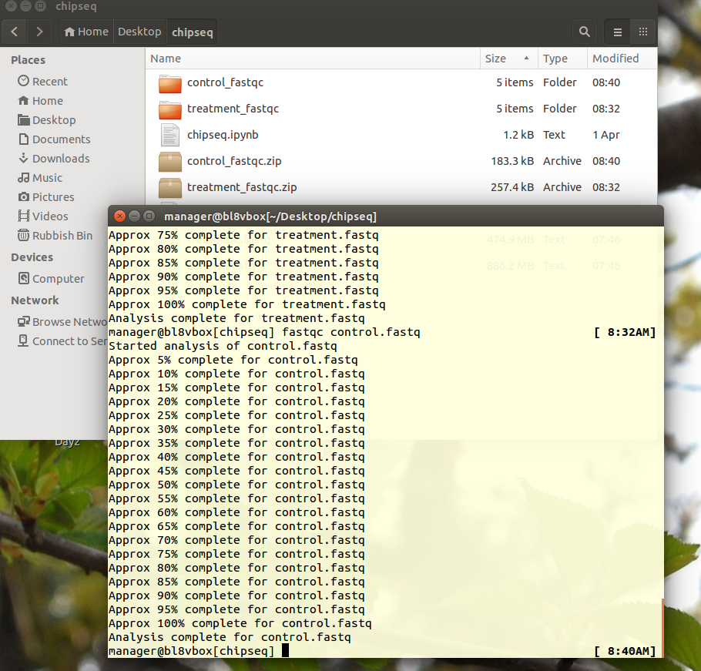

Slide 21
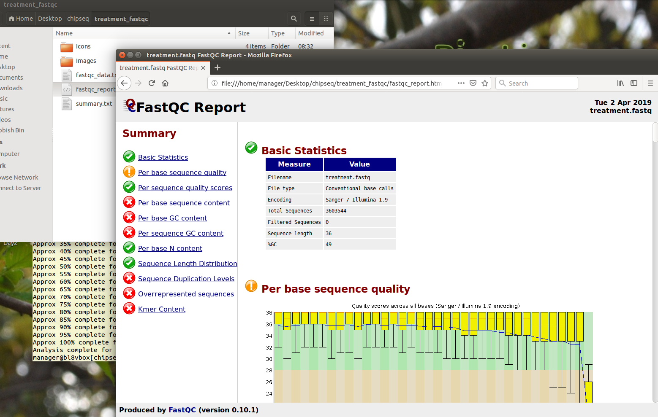
Quality Check FastQC

Slide 22
Mapping

Slide 23
Build Bowtie Index

Slide 24
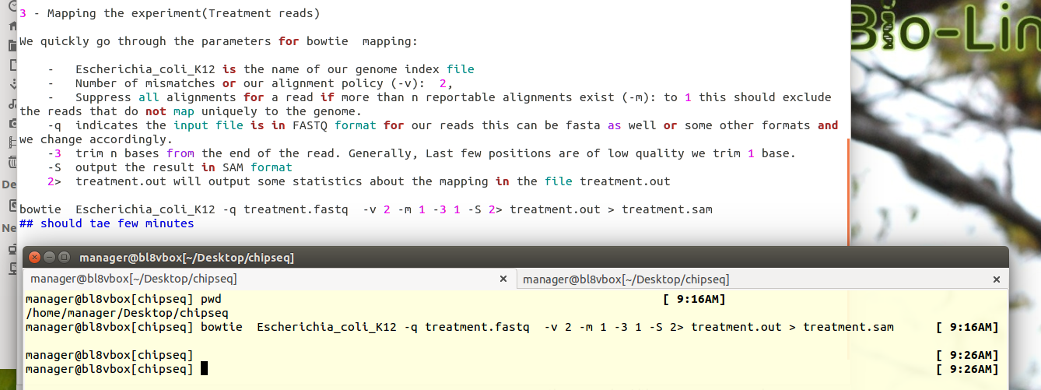
Mapping

Slide 25
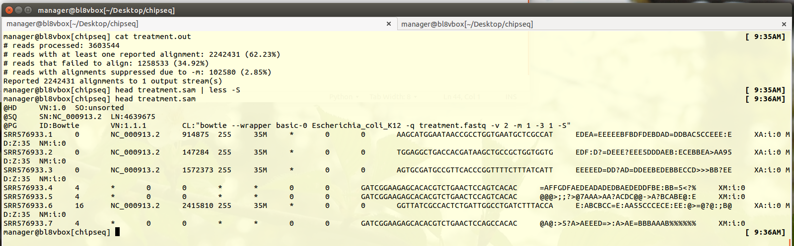
How many mapped in treatment ? Which format ?

Slide 26
Map the control

Slide 27
Simultaneously map both sample

Slide 28
Peak Finding using MACS [ Zhang et 2008 genome Biology]

Slide 29
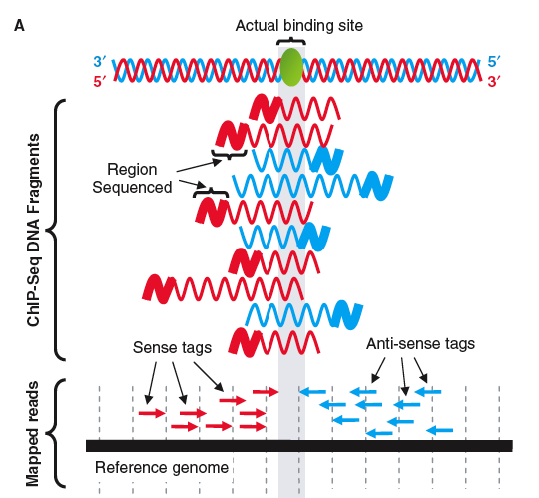
How do peak-finders locate binding sites?
Fragments are of a range of sizes & contain the TF binding site at a (mostly) random position within them.
Reads are read (randomly) from left or right edges (sense or antisense) of fragments.
Thus peak for sense tags will be 1/2 the fragment length upstream…
Binding site position = mid-way between sense tag peak & antisense tag peak.
To get binding site peak, shift sense downstream by ½ fragsize & antisense upstream by ½ fragsize.
From Gavin Schnitzler slides
Adapted from slide set by: Stuart M. Brown, Ph.D., Center for Health Informatics & Bioinformatics, NYU School of Medicine & from Jothi, et al. Genome-wide identification of in vivo protein–DNA binding sites from ChIP-Seq data. NAR (2008), 36: 5221-31

Slide 30
Reads peaks are not the location binding sites
Peak caller identify regions that have more reads than background
Thanks: Lauren Mills

Slide 33
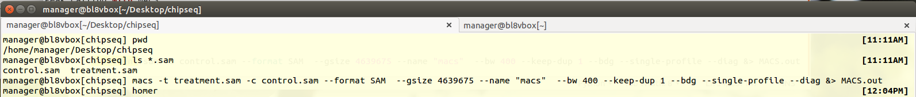
Peak finding by Running MACS

Slide 34
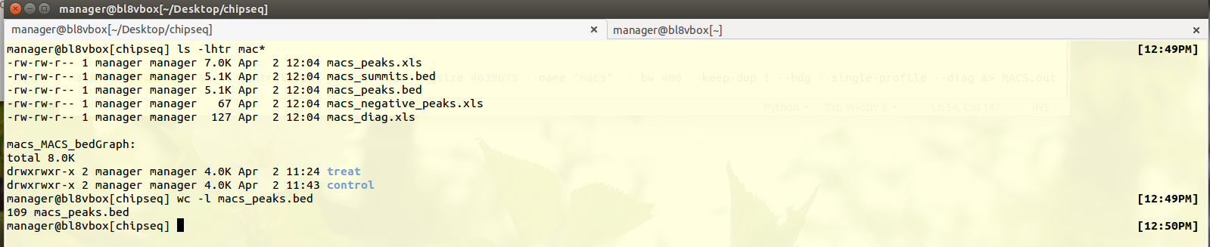
How many peaks ?

Slide 35
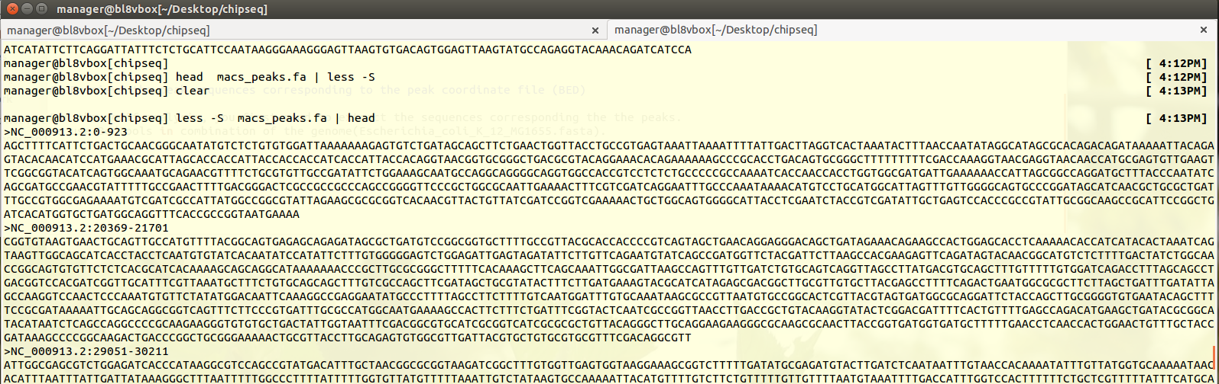
Extracting sequence from the peaks

Slide 36
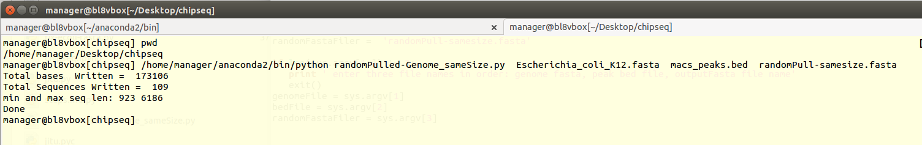
Make background peak sequence

Slide 37
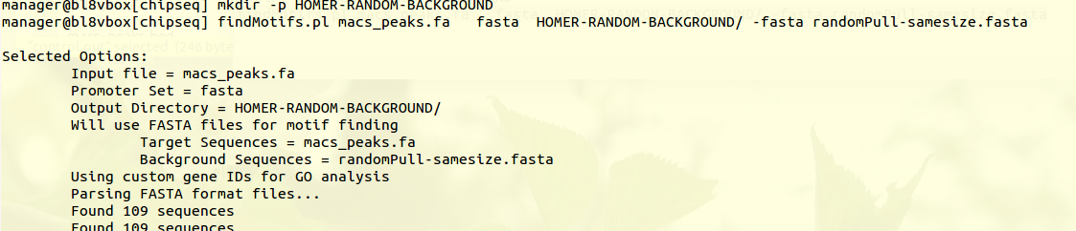
Find motifs: running HOMER

Slide 38
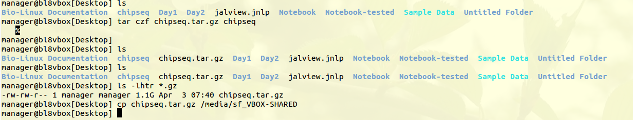
Save our results for later use…

Slide 39
RSAT - peak-motifs http://rsat.sb-roscoff.fr/peak-motifs_form.cgi

Slide 40
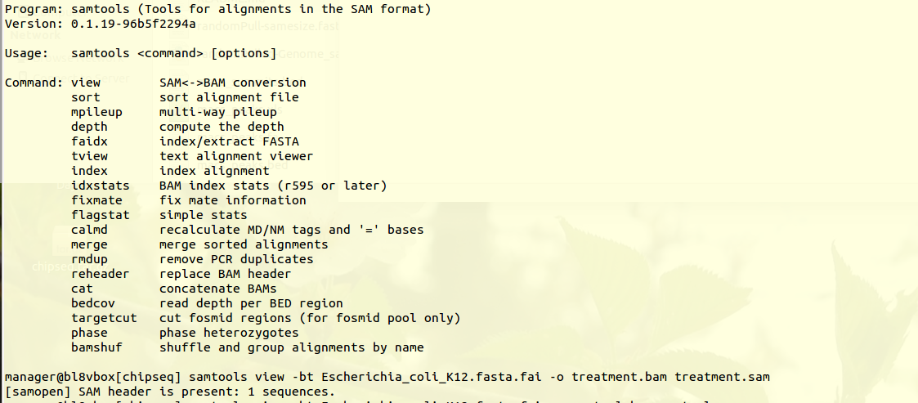
Sam to bam format conversion

Slide 41
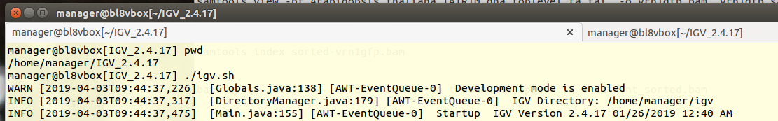
Load to IGV

Slide 42
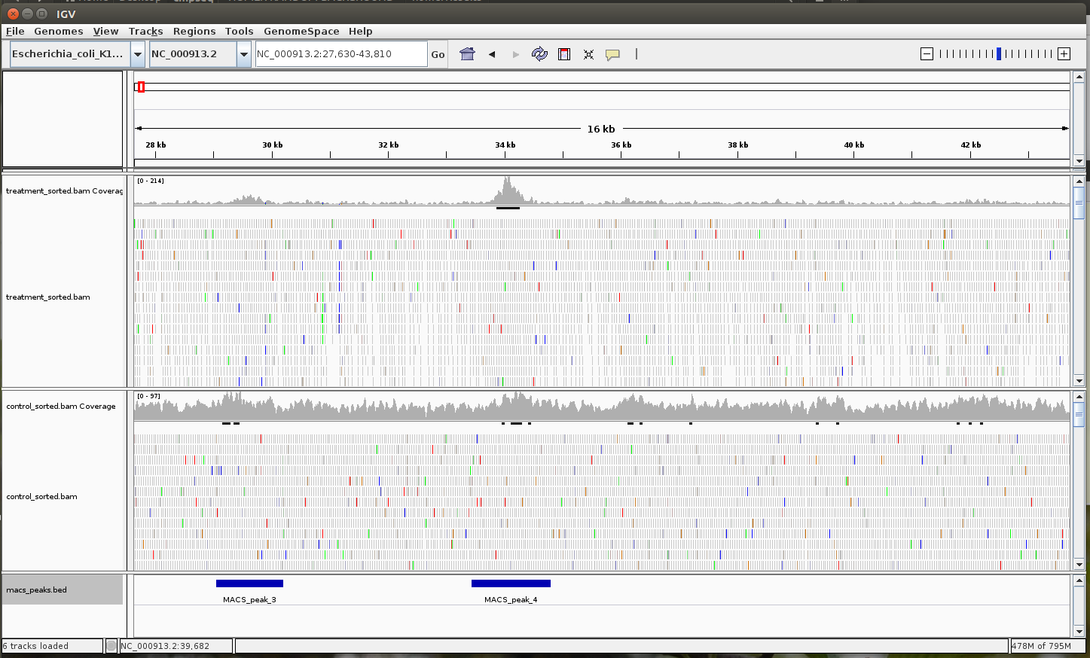
View in IGV

Slide 43
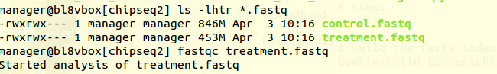
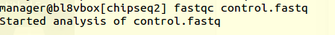
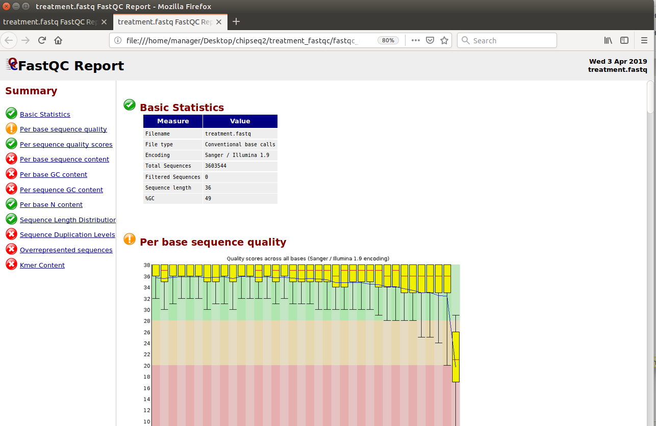
Second Round

Slide 44
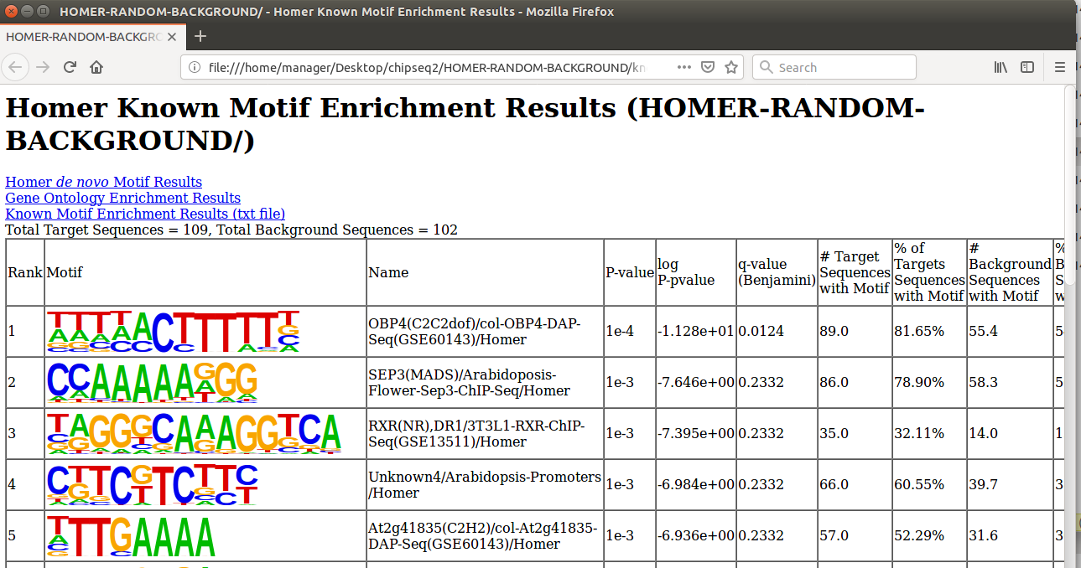

Slide 45
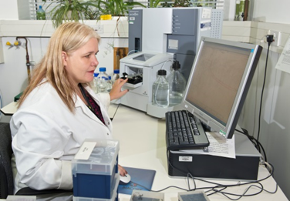
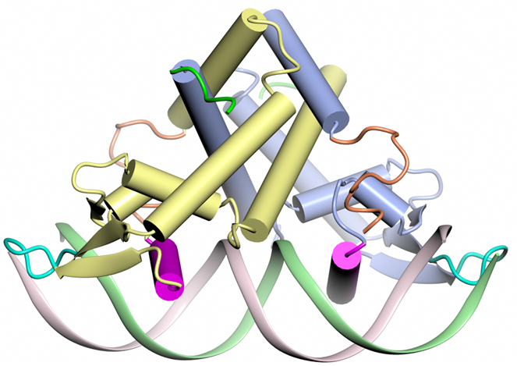
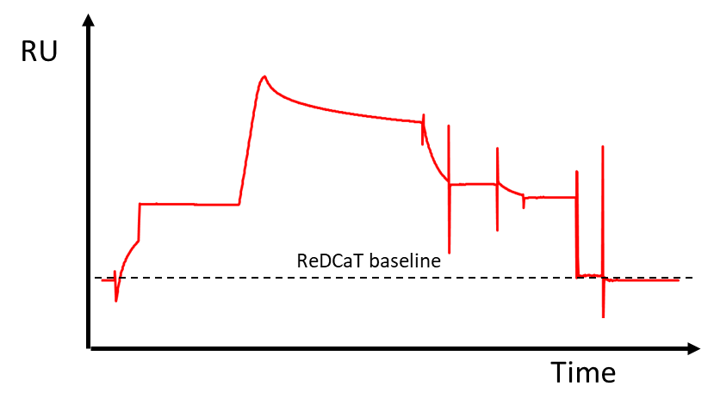
Validate your Chip-seq hits using Surface Plasmon Resonance
High throughput, quick, cheap method to study protein:DNA interactions
Available as part of the Biophysical Analysis Platform at JIC
Why?
Can identify and rank binding
Determine affinity and kinetics of the interaction
Test mutations in protein/DNA
Look at ligands/inhibitors
Requirements?
Purified protein (small amount)
DNA sequence to be tested (plus a linker on one strand)
Protein binds
Contact:
clare.stevenson@jic.ac.uk x2734 for more information

Slide 46
Thanks
If you need help with ChipSeq.
I am at Bateson Building Second Floor
Question ??

